Slide 1

Addressing Array Elements
Array elements can be accessed quickly if they are stored in a block of consecutive locations. In C and Java array elements are numbered 0,1,…n -1, for an array with n elements.
If the width of each array element is w, then the i^{th} element of array A begins in location. For a one dimensional array, address calculation will be
base+ i x w
where base is the relative address of the storage allocated for the array. That is, base is the relative address of A[0].
For a two dimensional array, the relative address of A[i1][i2] can then be calculated by the formula
In two dimensions, the location for A[i1][i2] is given by
base+(i₁x n₂ +i₂)x w

Slide 2
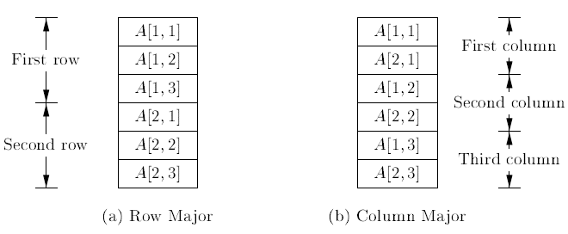
Layouts for a two dimensional array
The address calculations used here are based on row-major layout for arrays, which is used in C.
Column major form is used in the Fortran family of languages.

Slide 3

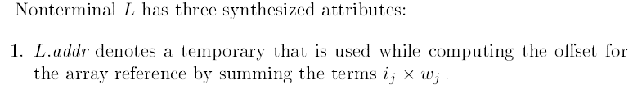
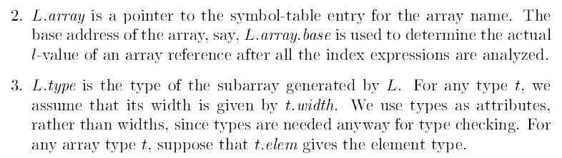
Translation of Array References
In C and Java , the lowest numbered array index element is 0.

Slide 4
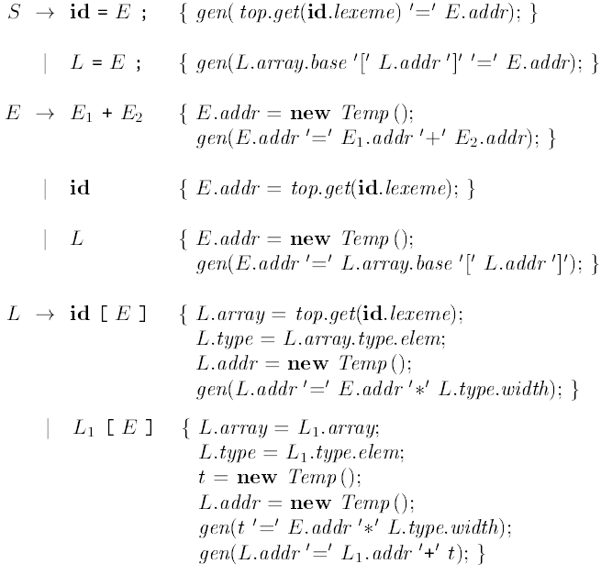

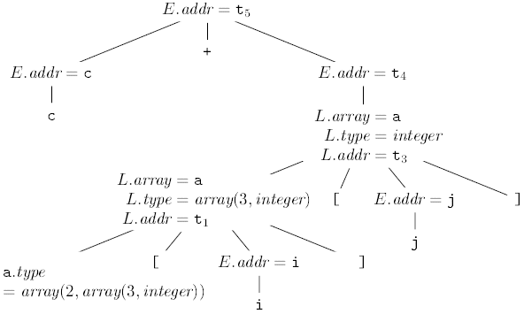
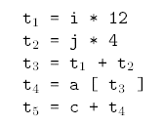
Semantic Actions for Array References

Slide 5
Use the Translation Scheme and translate the following assignment statements
x=a[ i ] + b[ j ]
Both a and b are integer arrays a[3] and b[2] respectively.

Slide 6

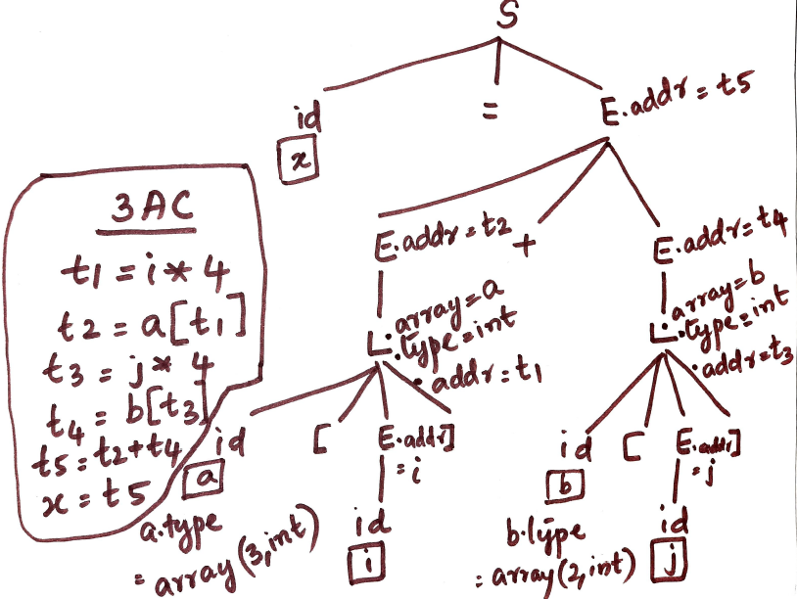
Translation of

